Slide 1
Knowledge Representation

Slide 2
Knowledge Representation

Slide 3
Background
One of the core problems in developing an intelligent system is knowledge representation, i.e., solving the problems of
(1) how to represent the knowledge one has about a problem domain, and
(2) how to reason using that knowledge in order to answer questions or make decisions
Knowledge representation deals with the problem of how to model the world sufficiently for intelligent action

Slide 4
Background (2)
Logic is one of the oldest representation languages studied for AI, and is the foundation for many existing systems that use logic as either inspiration or the basis for the tools in that system (e.g., rule-based expert systems and the Prolog programming language)
For a knowledge-based intelligent agent, we need:
To represent knowledge about the world in a formal language
To reason about the world using inferences in the language
To decide what action to take by inferring that the selected action is good

Slide 5
Representation Languages
Fundamental problem of designing a knowledge representation language is the fundamental tradeoff between:
(1) a language that is expressive enough to represent the important objects and relations in a problem domain, yet
(2) allows for a tractable (i.e., efficient) means of reasoning and answering questions about implicit information in a reasonable amount of time
Logic is a well-studied, general-purpose language for describing what's true and false in the world, along with mechanical procedures that can operate on sentences in the language to perform reasoning (i.e., to determine what "implicitly follows" from what is explicitly represented)

Slide 6
Knowledge Representation
A framework for storing knowledge and manipulating knowledge
Or
A set of syntactic and semantic conventions that make it possible to describe things
There is always a relationship between the form in which knowledge is represented and the way in which the knowledge is used.
You can use domain-specific or general-purpose representation.

Slide 7
What to represent
Let us first consider what kinds of knowledge might need to be represented in AI systems:
Objects --- Facts about objects in our world domain. e.g. cars have wheels, cows are herbivores.
Events -- Actions that occur in our world. e.g. The power-sharing deal was sealed on 28th February 2008
Performance -- A behavior like playing volleyball involves knowledge about how to do things like serve, boost, spike and block.
Meta-knowledge -- knowledge about what we know.

Slide 8
What to represent
Thus in solving problems in AI we must represent knowledge and
There are two entities to deal with, i.e. facts and representation of these.
Facts -- truths about the real world and what we represent.
This can be regarded as the knowledge level
Representation of the facts which we manipulate.
This can be regarded as the symbol level since we usually define the representation in terms of symbols that can be manipulated by programs.

Slide 9
Uses of knowledge
Knowledge may be used in the following ways:
Learning
acquiring knowledge. This is more than simply adding new facts to a knowledge base. New data may have to be classified prior to storage for easy retrieval, etc.. Interaction and inference with existing facts to avoid redundancy and replication in the knowledge and and also so that facts can be updated.
Retrieval
The representation scheme used can have a critical effect on the efficiency of the method. Humans are very good at it.
Many AI methods have tried to model humans

Slide 10
Uses of knowledge (2)
Reasoning
Infer facts from existing data.
If a system only knows: Daisy is a world class model. All world class models are beautiful.
If things like Is Daisy a world class model? or Are world class models beautiful? are asked then the answer is readily obtained from the data structures and procedures. However a question like Is Daisy beautiful? requires reasoning.
Note: The above are all related. For example, it is fairly obvious that learning and reasoning involve retrieval etc.

Slide 11
Properties of Knowledge Representation Systems
The following properties should be possessed by a knowledge representation system.
Representational Adequacy
the ability to represent the required knowledge;
Inferential Adequacy
the ability to manipulate the knowledge represented to produce new knowledge corresponding to that inferred from the original;

Slide 12
Properties-ctnd…
Inferential Efficiency
the ability to direct the inferential mechanisms into the most productive directions by storing appropriate guides;
Acquisitional Efficiency
the ability to acquire new knowledge using automatic methods wherever possible rather than reliance on human intervention.

Slide 13
Properties-ctnd…
Note:
To date no single system optimises all of the above.
Currently, logic based representation is still the theoretical foundation of various kinds of knowledge representation.

Slide 14
Knowledge Representation Schemes
A number of knowledge representation schemes (or formalisms) have been used to represent the knowledge of humans in a systematic manner. This knowledge is represented in a knowledge base such that it can be retrieved for solving problems. Amongst the well-established knowledge representation schemes are:
Natural language
Logic
Predicate and Propositional Logic
Conceptual or Terminological Logics
Production Rules
Semantic Networks
Frames
Conceptual Dependency Grammar
Conceptual Graphs
Ontology
XML / RDF

Slide 15
Logic Representation

Slide 16
Logic representation
Logic is a formal system in which the formulas or sentences have true or false values
A logic includes:
Syntax: Specifies the symbols in the language and how they can be combined to form sentences. Hence facts about the world are represented as sentences in logic
Semantics: Specifies what facts in the world, a sentence refers to. Hence, also specifies how you assign a truth value to a sentence based on its meaning in the world. A fact is a claim about the world, and may be true or false.
Inference Procedure: Mechanical method for computing (deriving) new (true) sentences from existing sentences

Slide 17
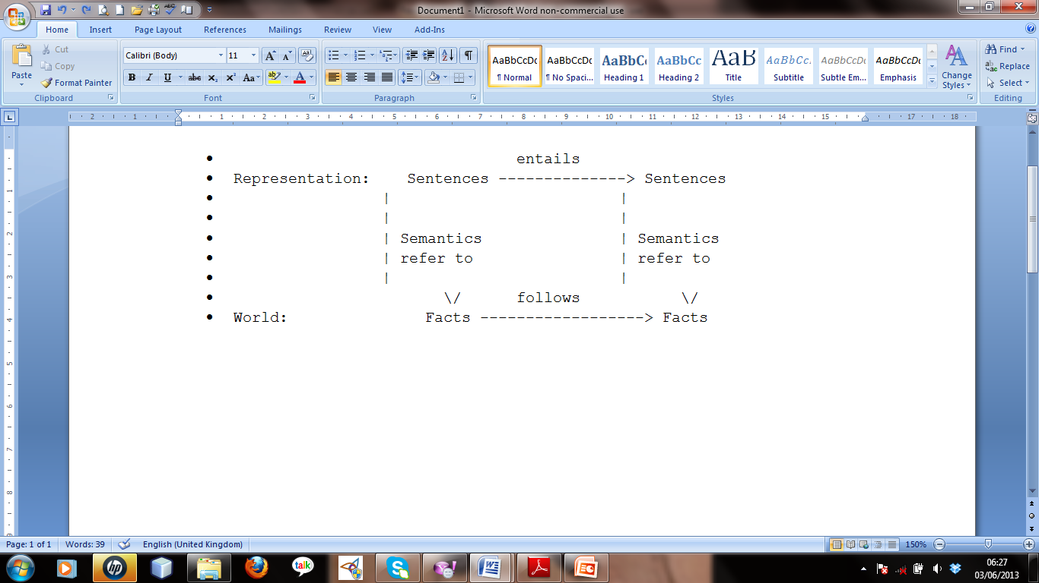
Logic representation (2)
Facts are claims about the world that are True or False, whereas a representation is an expression (sentence) in some language that can be encoded in a computer program and stands for the objects and relations in the world
We need to ensure that the representation is consistent with reality, so that the following figure holds:

Slide 18
Logic representation (3)
Truth: A sentence is True if the state of affairs it describes is actually the case in the world. So, truth can only be assessed with respect to the semantics. Yet the computer does not know the semantics of the knowledge representation language, so we need some way of performing inferences to derive valid conclusions even when the computer does not know what the semantics (the interpretation) is
To build a logic-based representation:
User defines a set of primitive symbols and the associated semantics
Logic defines the ways of putting these symbols together so that the user can define legal sentences in the language that represent true facts in the world
Logic defines ways of inferring new sentences from existing ones

Slide 19
Representation, Reasoning, and Logic
The objective of knowledge representation is to express knowledge in a computer-tractable form, so that agents can perform well.
A representation that has clear syntax and semantics is a logic representation
Logics include:
Propositional logic
Predicate logic (FOPC)
HOPC
Fuzzy Logic
Temporal logic
Description Logics
e.t.c.

Slide 20
Propositional Logic

Slide 21
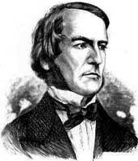
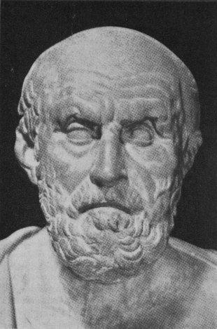
Propositional Logic
Topic #1 – Propositional Logic
Propositional Logic is the logic of compound statements built from simpler statements using so-called Boolean connectives.
Some applications in computer science:
Design of digital electronic circuits.
Expressing conditions in programs.
Queries to databases & search engines.
George Boole (1815-1864)
Chrysippus of Soli (ca. 281 B.C. – 205 B.C.)
Notes:
We normally attribute propositional logic to George Boole, who first formalized it. Actually the particular formal notation we will present is not precisely Boole’s; he originally spoke of logic in terms of sets, not propositions, and he also used Boolean algebra notation such as AB, A+B, rather than the A /\ B, A \/ B notation we will use. But, he was the first to mathematically formalize these kinds of concepts in preserved writings. Boole’s formalization of logic was developed further by the philosopher Frege.
However, even though logic was not formalized as such until the 1800’s, the basic ideas of it go all the way back to the ancient Greeks. Aristotle (ca. 384-322 B.C.) developed a detailed system of logic (though one that was not quite as convenient and powerful as the modern one), and Chrysippus of Soli (ca. 281-205 B.C.) introduced a logic centered around logic AND, inclusive and exclusive OR, NOT, and implication, similarly to Boole’s. Chrysippus’ logic apparently included all of the key rules that Boole’s logic had. However, his original works were unfortunately lost; we only have fragments quoted by other authors.

Slide 22
Definition of a Proposition
Topic #1 – Propositional Logic
Definition: A proposition (denoted p, q, r, …) is simply:
a statement (i.e., a declarative sentence)
with some definite meaning, (not vague or ambiguous)
having a truth value that’s either true (T) or false (F)
it is never both, neither, or somewhere “in between!”
However, you might not know the actual truth value,
and, the truth value might depend on the situation or context.

Slide 23
Propositional logic
Logical constants: true, false
Propositional symbols: P, Q, S, ... (atomic sentences)
Wrapping parentheses: ( … )
Sentences are combined by connectives:
∧ ...and [conjunction]
∨ ...or [disjunction]
⇒...implies [implication / conditional]
⇔..is equivalent [biconditional]
¬ ...not [negation]
Literal: atomic sentence or negated atomic sentence

Slide 24
Examples of PL sentences
(P ∧ Q) → R
“If it is hot and humid, then it is raining”
Q → P
“If it is humid, then it is hot”
Q
“It is humid.”
A better way:
Ho = “It is hot”
Hu = “It is humid”
R = “It is raining”

Slide 25
Propositional Logic: Syntax
Symbols:
Logical constants: true (T), false (F)
Propositional symbols: P, Q, S, ...
logical connectives:
∧ ...conjunction (and) ∨ ...disjunction (or)
¬ ...negation (not) => ...implication (if)
<=> ...logical equivalence (if and only if)
Wrapping parentheses: ( … )
A proposition (denoted by a proposition symbol) is a declarative statement which can be either true or false but not both or neither.
The moon is made of mursik (F)
Thika is closer to Nyeri than to Kisumu (T)

Slide 26
Syntax-2
Sentence
T or F itself is a sentence
Individual proposition symbols P, Q, ... are sentences
If S is a sentence, so is (S)
If S1 and S2 are sentences, so are
S1 ∧ S2, S1∨ S2, S1 => S2, S1 <=> S2, ¬ S1
Nothing else is a sentence
Order of precedence of logical connectors
¬ , ∧, ∨, => , <=>
Atomic sentences: T, F, P, Q, ... i.e. any capital letter
Literals: atomic sentences and their negations

Slide 27
Syntax-3
Example Sentences
P means "It is hot"
Q means "It is humid"
R means "It is raining"
P ^ Q => R
"If it is hot and humid, then it is raining"
Q => P
"If it is humid, then it is hot"
Q
"It is humid."

Slide 28
A BNF grammar of sentences in propositional logic
S := <Sentence> ;
<Sentence> := <AtomicSentence> | <ComplexSentence> ;
<AtomicSentence> := "TRUE" | "FALSE" |
"P" | "Q" | "S" ;
<ComplexSentence> := "(" <Sentence> ")" |
<Sentence> <Connective> <Sentence> |
"NOT" <Sentence> ;
<Connective> := "AND" | "OR" | "IMPLIES" | "EQUIVALENT" ;

Slide 29
Propositional Logic (PL): Semantics
Need an interpretation of symbols for a given set of sentences
Proposition symbols do not have meaning by themselves
An interpretation connects proposition symbols to a statement about the world (which may be true or false in that world)
An interpretation in PL can be defined as an assignment of truth values to all proposition symbols involved
There are many interpretations for a given set of sentences (2^n if they involve n distinct proposition symbols)
Example: Use truth tables to provide semantics
Give a meaning to each logical connectives
Provide semantics

Slide 30
Interpretation and Truth Tables
Truth table gives us operational definitions of important logical operators.
By using truth table, the truth values of well-formed formulae are calculated.
Truth table elaborates all possible truth values of a formula.
The meanings of the logical operators are given by the following truth table.
P Q ~P P Λ Q P V Q P → Q P ↔ Q
T T F T T T T
T F F F T F F
F T T F T T F
F F T F F T T

Slide 31
Some definitions
A model is an interpretation of a set of sentences such that every sentence is True. A model is just a formal mathematical structure that "stands in" for the world.
A sentence is satisfiable if it is True under some interpretation(s)
A valid sentence or tautology is a sentence that is True under all possible interpretations, no matter what the world is actually like or what the semantics is, e.g., it is raining or it is not raining
An inconsistent sentence or contradiction is a sentence that is False under all interpretations. The world is never like what it describes, e.g., “it is raining and it is not raining”
P entails Q (Q is a logical consequence of P, Q logically follows P), written P |= Q, means that whenever P is True, so is Q. In other words, all models of P are also models of Q. e.g. ((P=>Q) AND P)=>Q

Slide 32
Some terms
The meaning or semantics of a sentence determines its interpretation.
Given the truth values of all symbols in a sentence, it can be “evaluated” to determine its truth value (True or False).
A model for a KB is a “possible world” (assignment of truth values to propositional symbols) in which each sentence in the KB is True.
A model is an interpretation of a set of sentences such that every sentence is True. A model is just a formal mathematical structure that "stands in" for the world.

Slide 33
Inference Rules
Logical Inference is used to create new sentences X that logically follow from a given set of sentences S (in KB and from input), i.e., S |- X
This kind of inference is also known as deduction. It can be done by constructing truth tables.
Below are some examples of rules of inference.
Each can be shown to be sound using a truth table -- a rule is sound if it’s conclusion is true whenever the premise is true.

Slide 34
Inference rules-1
An inference rule is sound if every sentence X produced by an inference rule operating on a KB logically follows from the KB. (That is, the inference rule does not create any contradictions)
An inference rule is complete if it is able to produce every expression that logically follows from (is entailed by) the KB. (Note the analogy to complete search algorithms.)

Slide 35
Inference Rules-2
RULE PREMISE CONCLUSION
Modus Ponens A, A => B B
Modus Tollens ¬B, A => B ¬ A
And Introduction A, B A ^ B
And Elimination A ^ B A
Or Introduction A A v B
Double Negation ¬ ¬ A A
Chaining A => B, B => C A => C
Resolution rule
Unit Resolution A v B, ¬ A B
Resolution A v B, ¬ B v C A v C

Slide 36
Weakness of PL
Hard to identify "individuals." E.g., Mary, 3
Individuals cannot be PL sentences themselves.
Difficult to directly and clearly talk about properties of individuals or relations between individuals (hard to connect individuals to class properties).
E.g., property of being a human implies property of being mortal
Generalizations, patterns, regularities can't easily be represented.
All members of a class have this property
Some member of a class have this property

Slide 37
Weaknesses of PL-2
A better representation is needed to capture the relationship (and distinction) between objects and classes, including properties belonging to classes and individuals
First-Order Logic (abbreviated FOL or FOPC) is expressive enough to concisely represent this kind of situation by separating classes and individuals
It has an Explicit representation of individuals and classes, x, Mary, 3, persons.
And also Adds relations, variables, and quantifiers, e.g.,
“Every person is mortal” Forall X: person(X) => mortal(X)
“There is a white alligator” There exists some X: Alligator(X) ^ white(X)

Slide 38
Propositional logic: Summary
The process of deriving new sentences from old one is called inference.
Sound inference processes derives true conclusions given true premises
Complete inference processes derive all true conclusions from a set of premises
A valid sentence is true in all worlds under all interpretations
If an implication sentence can be shown to be valid, then—given its premise—its consequent can be derived
Different logics make different commitments about what the world is made of and what kind of beliefs we can have regarding the facts
Logics are useful for the commitments they do not make because lack of commitment gives the knowledge base engineer more freedom
Propositional logic commits only to the existence of facts that may or may not be the case in the world being represented
It has a simple syntax and simple semantics. It suffices to illustrate the process of inference
Propositional logic quickly becomes impractical, even for very small worlds

Slide 39
First Order Logic
Also First Order predicate Calculus

Slide 40
First Order (Predicate) Logic (FOL)
First-order logic is used to model the world in terms of
objects which are things with individual identities
e.g., individual students, lecturers, companies, cars ...
properties of objects that distinguish them from other objects
e.g., mortal, blue, oval, even, large, ...
classes of objects (often defined by properties)
e.g., human, mammal, machine, ...
relations that hold among objects
e.g., brother of, bigger than, outside, part of, has color, occurs after, owns, a member of, ...
functions which are a subset of the relations in which there is only one ``value'' for any given ``input''.
e.g., father of, best friend, second half, one more than ...

Slide 41
Representing knowledge in FOL
Typically, the user provides:
Constant symbols, which represent individuals in the world
Mary
3
Green
Function symbols, which map individuals to individuals
father-of(Mary) = John
color-of(Sky) = Blue
Predicate symbols, which map individuals to truth values
greater(5,3)
green(Grass)
color(Grass, Green)

Slide 42
Representing Knowledge in FOL Provides
Thereafter, FOL provides:
Variable symbols
E.g., x, y, z
Connectives
Same as in PL: not (¬), and (∧), or (∨), implies (→), if and only if (biconditional ↔)
Quantifiers
Universal ∀x or (Ax)
Existential ∃x or (Ex)
The features provided by FOL form part of its grammar

Slide 43
Syntax of FOL
Predicates: P(x[1], ..., x[n])
P: predicate name; (x[1], ..., x[n]): argument list
A special function with range = {T, F};
Examples: human(x), /* x is a human */
father(x, y) /* x is the father of y */
When all arguments of a predicate is assigned values (said to be instantiated), the predicate becomes either true or false, i.e., it becomes a proposition. Ex. Father(Fred, Joe)
A predicate, like a membership function, defines a set (or a class) of objects

Slide 44
Syntax of FOL-2
Terms (arguments of predicates must be terms)
Constants are terms (e.g., Fred, a, Z, “red”, etc.)
Variables are terms (e.g., x, y, z, etc.), a variable is instantiated when it is assigned a constant as its value
Functions of terms are terms (e.g., f(x, y, z), f(x, g(a)), etc.)
A term is called a ground term if it does not involve variables
Predicates, though special functions, are not terms in FOL

Slide 45
Syntax of FOL-3
Quantifiers
Universal quantification ∀ (or forall)
(∀x)P(x) means that P holds for all values of x in the domain associated with that variable.
E.g., (∀x) luo(x) => kenyan(x)
(∀x) kenyan(x) => african(x)
Universal quantifiers often used with "implication (=>)" to form "rules" about properties of a class
(∀x) student(x) => smart(x) (All students are smart)

Slide 46
Syntax of FOL-4
Often associated with English words “all”, “everyone”, “always”, etc.
You rarely use universal quantification to make blanket statements about every individual in the world (because such statement is hardly true)
(∀x)student(x)^smart(x) means everyone in the world is a student and is smart.

Slide 47
Syntax of FOL-5
Existential quantification ∃
(∃x)P(x) means that P holds for some value(s) of x in the domain associated with that variable.
E.g., (∃x) mammal(x) ^ lays-eggs(x)-there is a mammal that lays eggs
Existential quantifiers usually used with “^ (and)" to specify a list of properties about an individual.
(∃x) student(x) ^ smart(x) (there is a student who is smart.)
A common mistake is to represent this English sentence as the FOL sentence:
(∃x) student(x) => smart(x)
Often associated with English words “someone”, “sometimes”, etc.
All variables need to be quantified.

Slide 48
A BNF for FOL
S := <Sentence> ;
<Sentence> := <AtomicSentence> |
<Sentence> <Connective> <Sentence> |
<Quantifier> <Variable>,... <Sentence> |
"NOT" <Sentence> |
"(" <Sentence> ")";
<AtomicSentence> := <Predicate> "(" <Term>, ... ")" |
<Term> "=" <Term>;
<Term> := <Function> "(" <Term>, ... ")" |
<Constant> |
<Variable>;
<Connective> := "AND" | "OR" | "IMPLIES" | "EQUIVALENT";
<Quantifier> := "EXISTS" | "FORALL" ;
<Constant> := "A" | "X1" | "John" | ... ;
<Variable> := "a" | "x" | "s" | ... ;
<Predicate> := "Before" | "HasColor" | "Raining" | ... ;
<Function> := "Mother" | "LeftLegOf" | ... ;

Slide 49
Sentences are built from terms and atoms
A term (denoting a individual in the world) is a constant symbol, a variable symbol, or a function of terms.
An atom (atomic sentence) is a predicate P(x[1], ..., x[n])
Ground atom: all terms in its arguments are ground terms (does not involve variables)
A ground atom has value true or false (like a proposition in PL)
A literal is either an atom or a negation of an atom
A sentence is an atom, or,
~P, P v Q, P ^ Q, P => Q, P <=> Q, (P) where P and Q are sentences
If P is a sentence and x is a variable, then (∀x)P and (∃x)P are sentences
A well-formed formula (wff) is a sentence containing no "free" variables. i.e., all variables are "bound" by universal or existential quantifiers.
(∀x)P(x,y) has x bound as a universally quantified variable, but y is free.

Slide 50
Translating English to FOL-Examples
Every gardener likes the sun.
(∀x) gardener(x) => likes(x,Sun)
Not Every gardener likes the sun.
~((∀x) gardener(x) => likes(x,Sun))
You can fool some of the people all of the time.
(∃x)(∀t) person(x) ^ time(t) => can-be-fooled(x,t)
You can fool all of the people some of the time.
(∀x)(∃t) person(x) ^ time(t) => can-be-fooled(x,t)
(the time people are fooled may be different)
You can fool all of the people at some time.
(∃t)(∀x) person(x) ^ time(t) => can-be-fooled(x,t)
(all people are fooled at the same time)
You can not fool all of the people all of the time.
~((∀x)(∀t) person(x) ^ time(t) => can-be-fooled(x,t))
Everyone is younger than his father
(∀x) person(x) => younger(x, father(x))

Slide 51
Examples-2
All purple mushrooms are poisonous.
(∀x) (mushroom(x) ^ purple(x)) => poisonous(x)
No purple mushroom is poisonous.
~(∃x) purple(x) ^ mushroom(x) ^ poisonous(x)
(∀x) (mushroom(x) ^ purple(x)) => ~poisonous(x)
There are exactly two purple mushrooms.
(∃x)(Ey) mushroom(x) ^ purple(x) ^ mushroom(y) ^ purple(y) ^ ~(x=y) ^
(∀z) (mushroom(z) ^ purple(z)) => ((x=z) v (y=z))
Clinton is not tall.
~tall(Clinton)
X is above Y if X is directly on top of Y or there is a pile of one or more other objects directly on top of one another starting with X and ending with Y.
(∀x)(∀y) above(x,y) <=> (on(x,y) v (∃z) (on(x,z) ^ above(z,y)))

Slide 52
Semantics of FOL
Domain M: the set of all objects in the world (of interest)
Interpretation I: includes
Assign each constant to an object in M
Define each function of n arguments as a mapping M^n => M
Define each predicate of n arguments as a mapping M^n => {T, F}
Therefore, every ground predicate with any instantiation will have a truth value
In general there are infinite number of interpretations because |M| is infinite
Define semantics of logical connectives: ~, ^, v, =>, <=> as in PL
Define semantics of (∀x) and (∃x)
(∀x) P(x) is true iff P(x) is true under all interpretations
(∃x) P(x) is true iff P(x) is true under some interpretation

Slide 53
Connections between All and Exists
We can relate sentences involving ∀ and ∃ using De Morgan’s laws:
(∀x) ¬P(x) ↔ ¬(∃x) P(x)
¬(∀x) P ↔ (∃x) ¬P(x)
(∀x) P(x) ↔ ¬ (∃x) ¬P(x)
(∃x) P(x) ↔ ¬(∀x) ¬P(x)

Slide 54
Quantified inference rules
Universal instantiation
∀x P(x) ∴ P(A)
Universal generalization
P(A) ∧ P(B) … ∴ ∀x P(x)
Existential instantiation
∃x P(x) ∴P(F) ← skolem constant F
Existential generalization
P(A) ∴ ∃x P(x)

Slide 55
Universal instantiation (a.k.a. universal elimination)
If (∀x) P(x) is true, then P(C) is true, where C is any constant in the domain of x
Example:
(∀x) eats(Nevin, x) ⇒ eats(Nevin, IceCream)
The variable symbol can be replaced by any ground term, i.e., any constant symbol or function symbol applied to ground terms only

Slide 56
Existential instantiation (a.k.a. existential elimination)
From (∃x) P(x) infer P(c)
Example:
(∃x) eats(Garland, x) → eats(Garland, Stuff)
Note that the variable is replaced by a brand-new constant not occurring in this or any other sentence in the KB
Also known as skolemization; constant is a skolem constant
In other words, we don’t want to accidentally draw other inferences about it by introducing the constant
Convenient to use this to reason about the unknown object, rather than constantly manipulating the existential quantifier

Slide 57
Existential generalization (a.k.a. existential introduction)
If P(c) is true, then (∃x) P(x) is inferred.
Example
eats(Nevin, IceCream) ⇒ (∃x) eats(Nevin, x)
All instances of the given constant symbol are replaced by the new variable symbol
Note that the variable symbol cannot already exist anywhere in the expression

Slide 58
Example: A simple genealogy KB by FOL
Build a small genealogy knowledge base using FOL that
contains facts of immediate family relations (spouses, parents, etc.)
contains definitions of more complex relations (ancestors, relatives)
is able to answer queries about relationships between people
Predicates:
parent(x, y), child(x, y), father(x, y), daughter(x, y), etc.
spouse(x, y), husband(x, y), wife(x,y)
ancestor(x, y), descendant(x, y)
male(x), female(y)
relative(x, y)
Facts:
husband(Joe, Mary), son(Fred, Joe)
spouse(John, Nancy), male(John), son(Mark, Nancy)
father(Jack, Nancy), daughter(Linda, Jack)
daughter(Liz, Linda)
etc.

Slide 59
Rules for genealogical relations
(∀x,y) parent(x, y) ↔ child (y, x)
(∀x,y) father(x, y) ↔ parent(x, y) ∧ male(x) (similarly for mother(x, y))
(∀x,y) daughter(x, y) ↔ child(x, y) ∧ female(x) (similarly for son(x, y))
(∀x,y) husband(x, y) ↔ spouse(x, y) ∧ male(x) (similarly for wife(x, y))
(∀x,y) spouse(x, y) ↔ spouse(y, x) (spouse relation is symmetric)
(∀x,y) parent(x, y) → ancestor(x, y)
(∀x,y)(∃z) parent(x, z) ∧ ancestor(z, y) → ancestor(x, y)
(∀x,y) descendant(x, y) ↔ ancestor(y, x)
(∀x,y)(∃z) ancestor(z, x) ∧ ancestor(z, y) → relative(x, y)
(related by common ancestry)
(∀x,y) spouse(x, y) → relative(x, y) (related by marriage)
(∀x,y)(∃z) relative(z, x) ∧ relative(z, y) → relative(x, y) (transitive)
(∀x,y) relative(x, y) ↔ relative(y, x) (symmetric)
Queries
ancestor(Jack, Fred) /* the answer is yes */
relative(Liz, Joe) /* the answer is yes */
relative(Nancy, Matthew)
/* no answer in general, no if under closed world assumption */
(∃z) ancestor(z, Fred) ∧ ancestor(z, Liz)

Slide 60
Higher Order Logic

Slide 61
Higher order logic
FOL only allows to quantify over variables, and variables can only range over objects.
HOL allows us to quantify over relations
Example: (quantify over functions)
“two functions are equal iff they produce the same value for all arguments”
∀f ∀g (f = g) <=> (∀x f(x) = g(x))
Example: (quantify over predicates)
∀r transitive( r ) => (∀xyz) r(x,y) ^ r(y,z) => r(x,z))
More expressive, but undecidable.

Slide 62
Other KR Schemes

Slide 63
Production Rules
The human mental process is internal, and it is too complex to be represented as an algorithm. However, most experts are capable of expressing their knowledge in the form of rules for problem solving.
IF the ‘traffic light’ is green
THEN the action is go
IF the ‘traffic light’ is red
THEN the action is stop
Two types of production rules exist:
Inference-type production rule
Both antecedents and consequents are assertions about data in STM.
Situation action rules
Antecedent is a logical combination of assertions about the data in STM and consequent is a collection of actions that change STM.

Slide 64
Production Rules (2)
The term rule in AI, which is the most commonly used type of knowledge representation, can be defined as an IF-THEN structure that relates given information or facts in the IF part to some action in the THEN part.
A rule provides some description of how to solve a problem. Rules are relatively easy to create and understand.
Any rule consists of two parts:
the IF part, called the antecedent (premise or condition)
and the THEN part called the consequent (conclusion or action).
A rule can have multiple antecedents joined by the keywords AND (conjunction), OR (disjunction) or a combination of both.

Slide 65
Production Rules (3)
Rules can represent relations, recommendations, directives, strategies and heuristics:
Relation
IF the ‘fuel tank’ is empty THEN the car is dead
Recommendation
IF the season is autumn AND the sky is cloudy AND the forecast is drizzle THEN the advice is ‘take an umbrella’
Directive
IF the car is dead AND the ‘fuel tank’ is empty
THEN the action is ‘refuel the car’

Slide 66
Production Rules (3)-b
Strategy
IF the car is dead THEN the action is ‘check the fuel tank’; step1 is complete
IF step1 is complete AND the ‘fuel tank’ is full
THEN the action is ‘check the battery’; step2 is complete
Heuristic
IF the spill is liquid AND the ‘spill pH’ < 6 AND the ‘spill smell’ is vinegar THEN the ‘spill material’ is ‘acetic acid’

Slide 67
Architecture of a Production System
Consists of three (3) parts:
Short term memory of facts (working memory)
A rule base composed of a set of production rules of the form antecedent=> consequent.
The antecedent comprises conditions that characterize the short term memory and the consequent comprise actions that manipulate the short term memory.
If the antecedent of the production rule is satisfied by the short-term memory then the production rule may be executed (fired).
The consequent of the production rule will change the content of the short-term memory so that other rules will have their conditions satisfied.
An interpreter that represents a mechanism to examine the short term memory and to determine which rules to fire. The following diagram represents the architecture of the production system.

Slide 68
Diagram
Interpreter
Condition 1 Action 1
Condition 2 Action 2
Condition N Action N
Short
Term
Memory

Slide 69
Reasoning with Production Rules
Production systems used as the basis for many rule-based expert systems
Reasoning in:
forward (situation-action rules) or
backward chaining (situation-action and inference rules)

Slide 70
Reasoning with Production Rules
Basic Inference Procedure
While changes are made to Working Memory do:
Match the current WM with the rule-base
Construct the Conflict Set -- the set of all possible (rule, facts) pairs where rule is from the rule-base, facts from WM that unify with the conditional part (i.e., LHS) of the rule.
Conflict Resolution: Instead of trying all applicable rules in the Conflict set, select one from the Conflict Set for execution. (depth-first)
Act/fire: Execute the actions associated with the conclusion part of the selected rule, after making variable substitutions determined by unification during match phase
Stop when conflict resolution fails to returns any (rule, facts) pair

Slide 71
Conflict Resolution Strategies
Refraction
A rule can only be used once with the same set of facts in WM. This strategy prevents firing a single rule with the same facts over and over again (avoiding loops)
Recency
Use rules that match the facts that were added most recently to WM, providing a kind of "focus of attention" strategy.
Specificity
Use the most specific rule, if one rule's LHS is a superset of the LHS of a second rule, then the first one is more specific
If one rule's LHS implies the LHS of a second rule, then the first one is more specific
Explicit priorities
E.g., select rules by their pre-defined order/priority
Rule order

Slide 72
Comparing Production Systems (PS) and FOL
Advantages
Simplicity (both KR language and inference),
Inference more efficient
Modularity of knowledge (rules are considered, to a degree, independent of each other), easy to maintain and update
Similar to the way humans express their knowledge in many domains
Can handle simple default reasoning
Disadvantages
No clearly defined semantics (may derive incorrect conclusions)
Inference is not complete (mainly due to the depth-first procedure)
Inference is sensitive to rule order, which may have unpredictable side effects
Less expressive (may not be suitable to some applications)
No explicit structure among pieces of knowledge in BOTH FOL (a un-ordered set of clauses) and PS (a list of rules)

Slide 73
Semantic Networks
A semantic network is a structure for representing knowledge as a pattern of interconnected nodes and arcs. Nodes in the net represent concepts of entities, attributes, events, values. Arcs in the network represent relationships that hold between the concepts.
A semantic network is a graph theoretic data structure whose nodes represent word senses and whose arcs express semantic relationships between these word senses.
Concepts can be represented as hierarchies of inter-connected concept nodes (e.g. animal, bird, canary)
Any concept has a number of associated attributes at a given level (e.g. animal --> has skin; eats etc.)
Some concept nodes are super class of other nodes (e.g. animal > bird) and some are sub classes (canary < bird)
Often, sub classes inherit all the attributes of their super class concepts.
Some instances of a concept are exempted from the having certain attributes held by their concept classes (e.g. ostrich is excepted from flying)

Slide 74
Semantic Networks- Exercises
Try to represent the following sentences using an appropriate semantic network diagram:
isa(person, mammal)
instance(Duggan Kariuki, person)
team(Duggan Kariuki, Cardiff) all in one graph
score(Gor Mahia, AFC, 3-1)
Misiko gave Ngicu the book

Slide 75
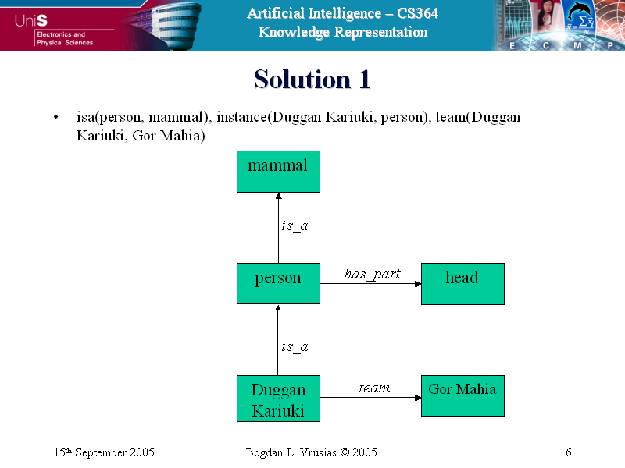
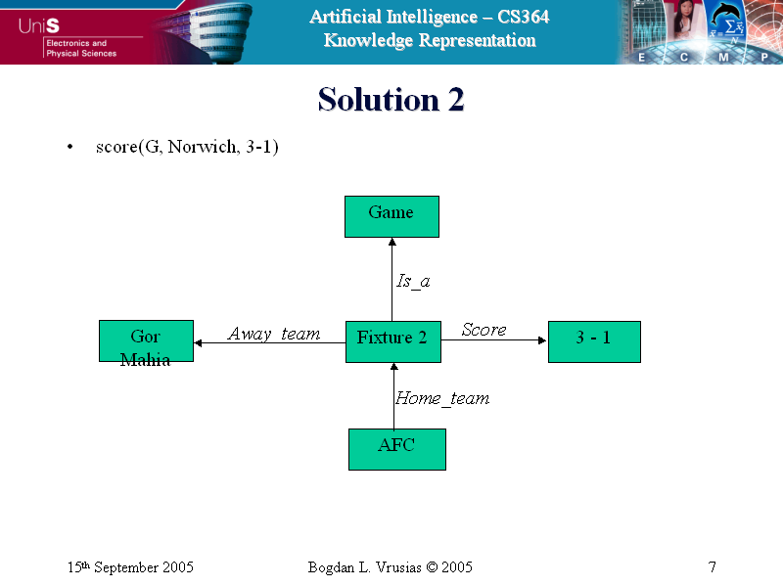
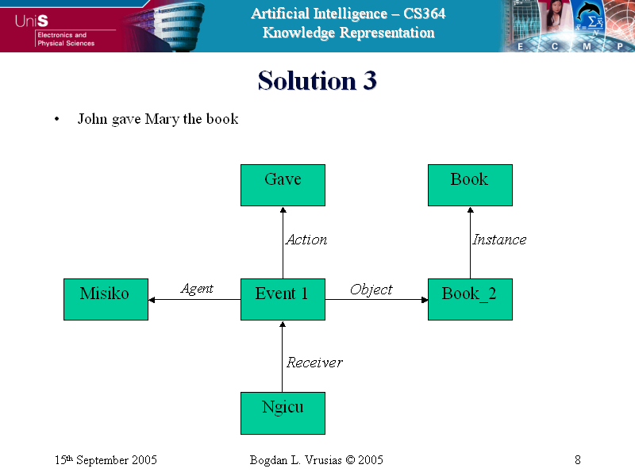
Semantic Networks- Solution

Slide 76
Advantages of Semantic Networks
Advantages
Easy to visualise and understand.
The knowledge engineer can arbitrarily define the relationships.
Related knowledge is easily categorised.
Efficient in space requirements.
Node objects represented only once.
Standard definitions of semantic networks have been developed.

Slide 77
Disadvantages of Semantic Networks
Limitations
The limitations of conventional semantic networks were studied extensively by a number of workers in AI:
Many believe that the basic notion is a powerful one and has to be complemented by, for example, logic to improve the notion’s expressive power and robustness.
Others believe that the notion of semantic networks can be improved by incorporating reasoning used to describe events.
Limited in handling quantifiers e.g. “Every dog has bitten a postman”
Binary relations are usually easy to represent, but some times is difficult.e.g. try to represent the sentence:
“Nengo caused trouble to the party".

Slide 78
Frames
stereotypical information on objects are represented- capture object attributes and then values.
A * indicates attribute is only true of a typical member of class and not necessarily every number.
Slots and slots values may also be frames.
Person
isa: Mammal
Cardinality:

Slide 79
Frames2
Adult-Male
isa: Person
Cardinality:
Football-Player
isa: Adult-Male
Cardinality:
Height:
Weight:
Position:
Team:
Team-Colours:
Striker
isa: Football-Player
Cardinality:
Goals:

Slide 80
Frames-3
Onditi
instance: Striker
Height: 6’0”
Position: Centre
Team: Gor Mahia
Team-Colours: Green/White
Football-Team
isa: Team
Cardinality:
Team-size: 11
Coach:
Gor Mahia
Instance:Foot-ball Team
Team size: 11
Coach: Haggai Nyang’
Players: {Onditi, Nyang, Jude, Mutero, Akidiva, Baraza,Patricia, Liz,…}

